Slide 1
Conducting a Data Inventory Sara Gonzales, MLIS Data Librarian
Galter Health Sciences Library & Learning Center
Northwestern University Feinberg School of Medicine

Slide 2

By the end of this workshop, you will have a roadmap for:
Planning a data inventory
Collecting data about your data
Cataloging your data
Making data inventorying a continuing effort
Next steps after inventorying your data

Slide 3
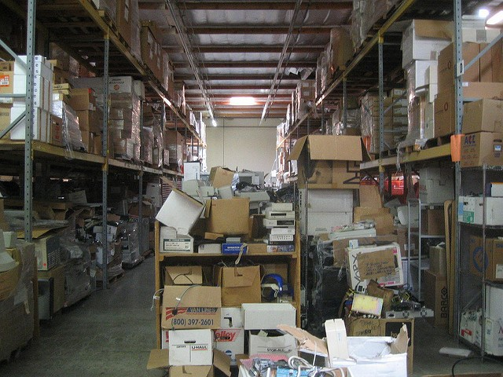
How the creation of data files gets out of control
A large volume of data files are generated in multiple types and from multiple sources
Storing files in multiple settings: Box, Google Drive, University servers
Lack of a clear folder structure on shared drives, either server or cloud-based
Lack of file-naming conventions, leading to individuals creating their own filenames
Lack of a “data steward” role – a staff member whose duties include creating and enforcing file-naming conventions, folder structures, backups and security for data, etc.
Image: https://www.flickr.com/photos/roland/1413399/ (Public Domain)

Slide 4

Solution: the Data Inventory
“A data inventory is a list of datasets with metadata that describes their contents, source, licensing, and other useful information.”
(Beale et. al., How to Create a Data Inventory, https://doi.org/10.21955/gatesopenres.1114885.1)
Image by Freepik: www.freepik.com/free-photos-vectors/background
Notes:
A data inventory can take any form you like, from a document to a spreadsheet to a database. The important things are that:
It lists every data asset you have for a project, no matter how small
It lists how the data were created and by whom
It lists any sources of changes to the data
It contains resources and advice for those who might come along later to use the data, even if this is you or someone in your project or team.

Slide 5
1.
Planning a Data Inventory

Slide 6
Questions to consider: inventory planning
What is the purpose of your inventory?
Define the scope
General data management
Identify new partnership opportunities
Preparing for data-sharing to meet funder requirements
How will the inventory project be sustained?
Can the creation and maintenance of the inventory be added to existing workflows?
Where will the end product of the inventory be hosted and accessed, and by whom?
Who will update the inventory?
Outline your definition of ‘data’
What does the word data encompass?
Datasets
Original raw data files
Paper-based assets
Data produced both out-of-house and within
Decide what level of detail you need
Will you inventory down to the level of individual datasets, or groups of them?
It’s easier to generalize from the granular level; more difficult to go back later for more detail
(Adapted from Beale et. al., How to Create a Data Inventory, https://doi.org/10.21955/gatesopenres.1114885.1)
Notes:
Knowing the purpose of your inventory helps you define its scope, and to decide what the end product will be. Along the way, this will help you decide what metadata to use to describe your data.
Do you envision this inventory as a one-time exercise, or do you plan to maintain it as an ongoing effort? If so, how can you ensure that it will be sustained, and how can you allot for the work to sustain it within your existing workflows?
Before inventorying anything, make sure the entire team agrees on what is meant by the terms data and datasets. Assets are less likely to be left out if everyone agrees on what constitutes data.
Decide at what level of detail to make notes on or catalog your data. If you envision needing detailed notes at some point in the future, then it is likely that every file will need to be reviewed.

Slide 7
Inventory planning: recording information
Data Audit Forms
DataSF’s Data Inventory Template from the City and County of San Francisco
State of South Carolina Data Inventory Tool
Create your own inventory tool. Things to consider:
Dataset name/file names
Dataset description and type
Subjects and keywords
Data owners/license
Tools that generated the data
Changes to data
Data quality/granularity
Spatial and temporal coverage

Slide 8
2.
Collecting Data about Your Data

Slide 9
Collecting the data: you don’t have to do it all yourself
Investigator
Graduate Students
Co-PI’s
Biostatistician
Clinical Research Coordinator
Lab Manager
Project Managers
Notes:
If you have a data auditing form in place, you can delegate some of the data collection work to those in your lab or on your project who currently serve as the ‘data owners.’ This could be a wide array of people, of which this diagram likely barely scratches the surface.

Slide 10

Conduct interviews with data owners and project managers
Who interacts with data
All the individuals who produce/update/change/manage/store data
Teams responsible for data
Labs & lab managers
People who receive data: research administrators, evaluators
Information to collect in interviews
Basic data descriptors as outlined in inventory forms
Uses to which data will be put by both the project team and people outside the team, but data-involved

Slide 11

Send surveys/questionnaires about the data
The same questions you would have asked in interviews can also be sent to data owners via a questionnaire. Include enough guidance to ensure consistency.
Ask for data owner and contributor details
Data collection tools: use standard names along with any shorthand
Encourage respondents to express dates and location names in consistent ways

Slide 12
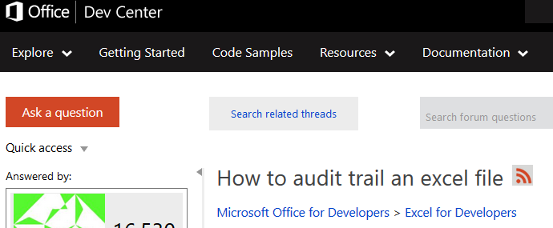
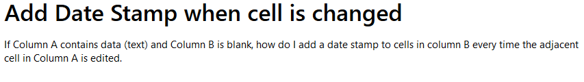
Automated inventory processes
Place your screenshot here
Are there automated processes you can build into your data files that show when changes were made, and by whom?
Is there a database for data collection that can leverage permissions, audit trails, and timestamps?
Caveat: keep audit information separate from raw data
Images courtesy of answers.microsoft.com and social.msdn.microsoft.com

Slide 13
To include in your data inventory: a long and growing list
Identification
File names
File types
File descriptions
Subjects/Keywords
Data owners
Data contributors
Data sources
Tools that generated or processed data
Granularity of data
Sensitivity level of data
Location
Study sites
Data collection sites
Storage solutions
Backups and versioning
Sources of secondary data
Repositories
Partner sites’ storage
Journals hosting shared data
Funder databases hosting shared data
Time
Data collection dates/times
Timing of changes made to data and frequency of changes
Data processing timelines
Frequency of data access
Reporting schedules
Embargos for data sharing
Team members’ tenures
Long-term retention solutions

Slide 14
3.
Cataloging Your Data

Slide 15

Record the inventory data you’ve collected
Create a ‘catalog’
Attribute | Description
Dataset Name | Unique name or identifier
Dataset Description | Describe the data asset
Dataset Creator | List creators’ names in Last Name, First Name order
Dataset Owner | List owner(s) of the dataset
Subject/Keywords | Free-text or controlled vocabulary dataset descriptors
Date of Creation | Date on which the data file was created
Time of Creation | Time at which data files were created
Data catalog table adapted from: Beale et. al., How to Create a Data Inventory, https://doi.org/10.21955/gatesopenres.1114885.1
Notes:
Before you begin to collect data about your data through your inventory, think about where this metadata will be recorded. A catalog of some kind, which can be accessed by all the stakeholders, referenced, and updated as needed, will be the most useful. This catalog can take the form of an Excel spreadsheet (and can be based on the data inventory templates referenced earlier), or a database created by project team members. The format is less important than collecting and cataloging the data in a consistent manner. Create variable names for all the data points you are collecting, and define them in a data dictionary style so they are easily understandable by the project team.

Slide 16

14.5 million metadata records
Over 50 published use cases
9 academic health science library partners
Your catalog can be mapped to common dataset schema
DataCite Metadata Schema 4.2
Data Catalog Vocabulary (DCAT) Ontology
Stats and references:
DataCite: stats.datacite.org/
DCAT Ontology: w3.org/TR/dcat-ucr/#UseCases
Data Catalog Collaboration Project: datacatalogcollaborationproject.org/dccp-resources
Data Catalog Collaboration Project Metadata Schema
Notes:
By inventorying your data on a regular basis, you are essentially cataloging it, or preparing it to be cataloged in a data- or institutional repository. You can reference these sources for dataset schema, or look at the metadata available in your local repository, DigitalHub (digitalhub.northwestern.edu). Even the popular Web markup language schema.org has a dataset extension (schema.org/dataset). This growth of dataset schema in recent years is due to increased demands from funders and publishers for access to publicly deposited data.

Slide 17
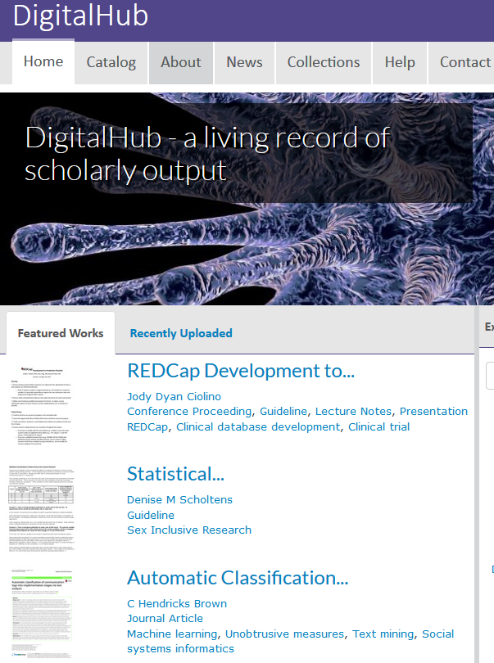
DigitalHub: a local resource
Place your screenshot here
If data has been inventoried and de-identified and is ready to be shared, consider depositing it in DigitalHub.
Benefits:
Allow others to cite your deposited data
Track versions
Share data with collaborators
Make collections
‘Private’ setting for data not ready to be shared

Slide 18
4. Make Data Inventorying a Continuing Effort

Slide 19
The inventory process so far
Plan your inventory
Collect Data about Your Data
Catalog this Data
How do we make an inventory more than a one-time effort?

Slide 20

Appoint a Data Steward
Accountable for the integrity and quality of project data
Create and uphold data standards and operating procedures
Naming conventions, folder structures
Develop data documentation
Ensure data security
Help ensure compliance (with funder requirements, sharing stipulations, etc.)
Be an advocate for data management on the team
Oversee and periodically re-launch inventories
Adapted from usgs.gov: Data Management: Stewardship: https://www.usgs.gov/products/data-and-tools/data-management/stewardship

Slide 21
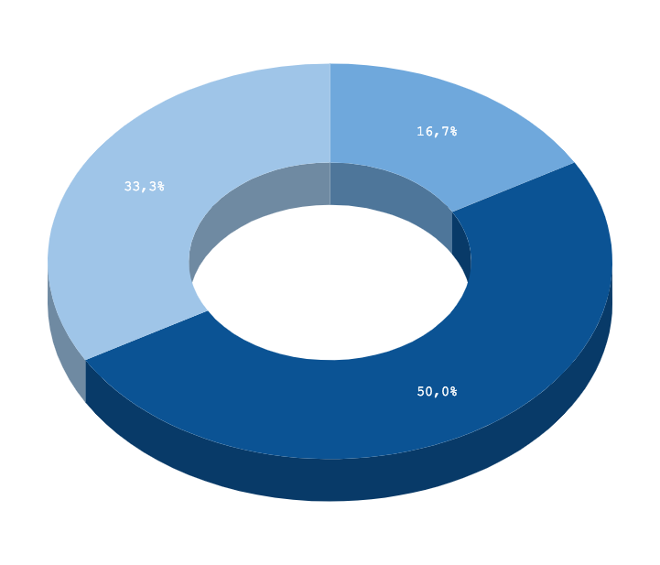
Set a schedule
Catalog the inventory data: October - November
If the entire data inventory process takes roughly half a year, brainstorm with your team about the best interval at which to repeat the process.
How often do significant changes to your team’s data take place? These signposts will help you to schedule the next inventory.
Plan inventory: May-June
Collect data about the data: July - September

Slide 22
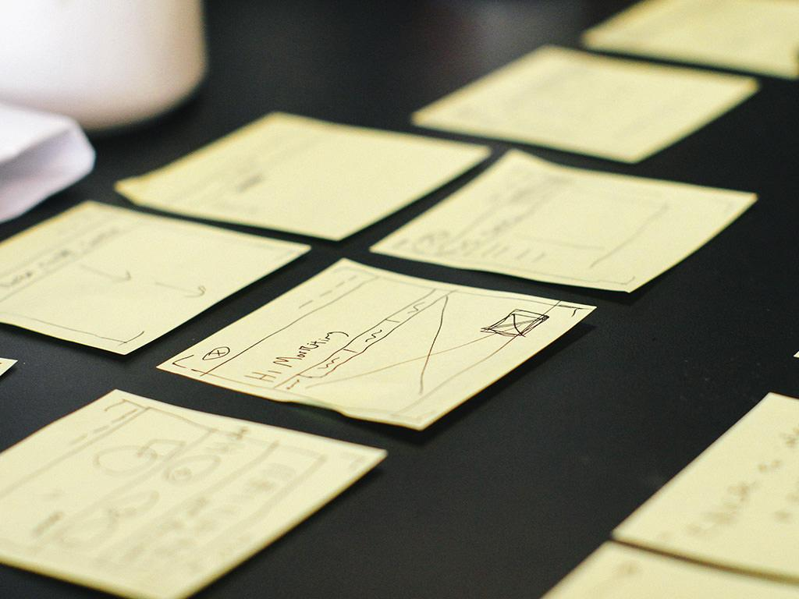
Manage the project
Notes:
Manage the data inventory project as closely as you would any other. Assign tasks, delegate duties, clearly define the deliverables, make a template for weekly progress reports. Identify blockers and deal with them in a timely manner so the overall project schedule is not affected.
For an ongoing effort, managing regular data inventories can be part of the job description/list of duties of your data steward. If the data steward role is shared among a few different team members, ask them to take turns managing individual inventory projects. As each person takes their turn at being project manager, they will come to appreciate the importance of completing inventory work in a timely and thorough manner.

Slide 23

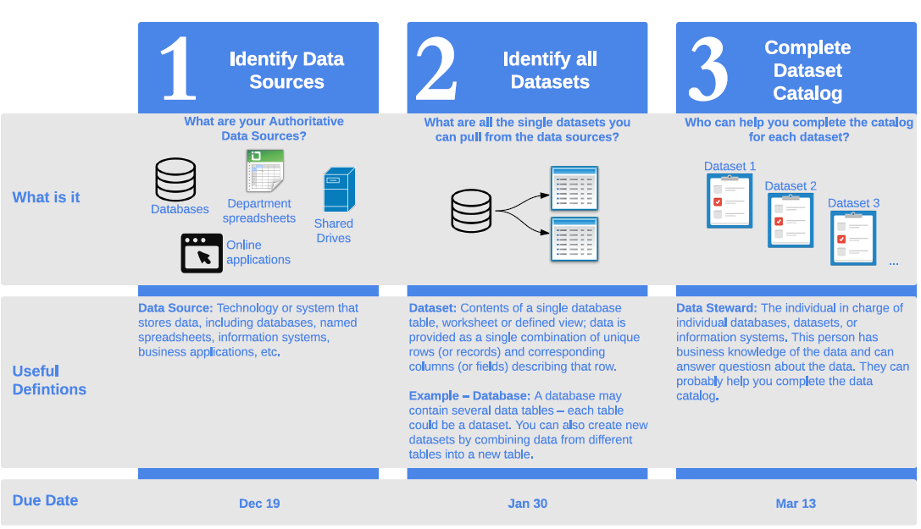
Create a flyer with your project steps
Images: Data San Francisco’s One Page Summary of Data Inventory Process: drive.google.com/uc?export=download&id=0B6av1JsL3xAnU25abC1wSFhXOG8
Freepik: freepik.com

Slide 24
5. Next Steps after Completing an Inventory

Slide 25
Where do we go from here?

Slide 26
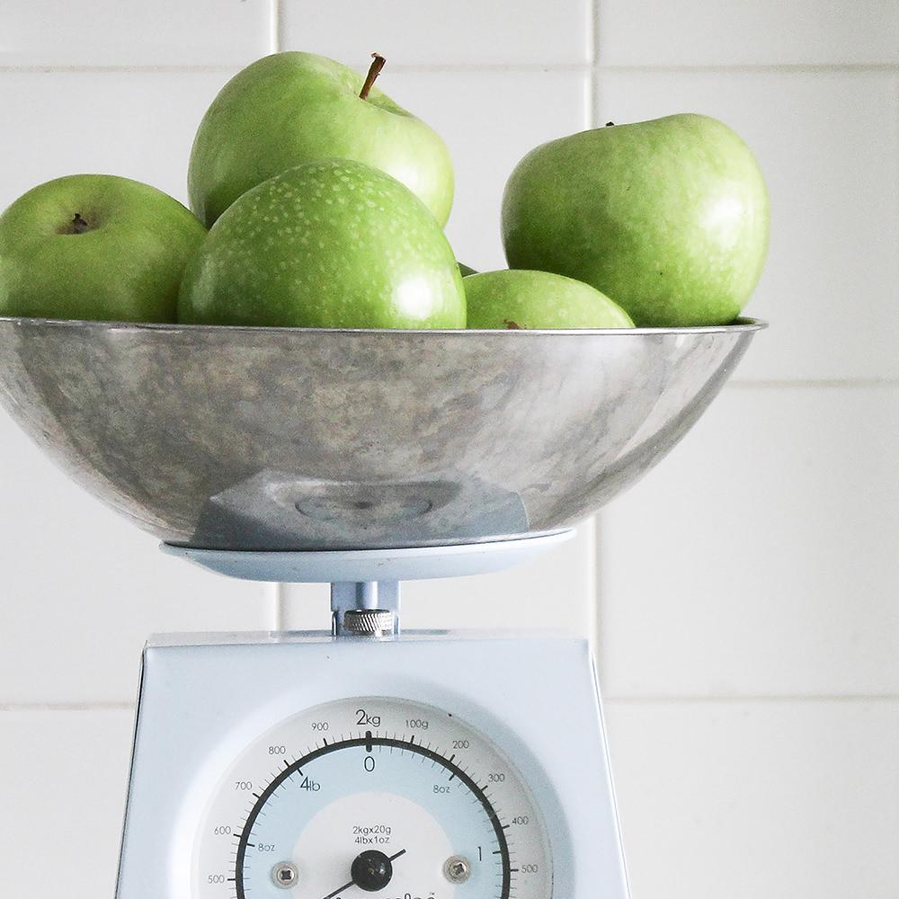
Leverage your inventory for maximum benefit
Research Data Management: use your inventory as a springboard to recommend better RDM practices
Develop policies: for file naming conventions, organizing file directories, storage and backups, quality and integrity checks
Implement the policies with practical guidelines
Establish a training program appropriate to staff needs
Planning: Use your inventory as an opportunity to budget for additional data curation and re-use work

Slide 27
Thanks!
Any questions?
You can find me at:
@saragon02 (GitHub)
sara.gonzales2@northwestern.edu

Slide 28

Credits
Beale, Tim, et. al. How to Create a Data Inventory. Open Data Institute, 2018. doi.org/10.21955/gatesopenres.1114885.1
San Francisco Open Data: DataSF. datasf.org/opendata/
State of South Carolina Data Inventory Tool
USGS.gov: Data Management, Stewardship: usgs.gov/products/data-and-tools/data-management/stewardship
Presentation template by SlidesCarnival licensed under a Creative Commons Attribution 4.0 International License (CC BY 4.0)
Photographs by Death to the Stock Photo (license) unless otherwise credited

